Slide 1
AZ-300T02 M 4: Securing Identities
Azure AD Identity Protection
Azure Domains and Tenants
Azure Users and Groups
Azure Roles
Azure AD Integration Options

Slide 2
Lesson 1: Azure AD Identity Protection
Video: Azure Identity Protection
Azure Identity Protection
Vulnerabilities Detected
Demonstration: Enabling Multi-Factor Authentication
Risky Sign-Ins
Risks Detected
Video: Enabling Azure Active Directory Protection

Slide 3
Video: Azure Identity Protection
Notes:
Create a new Azure Identity Protection option under marketplace
Create a Resource-Identity Azure AD Identity Protection
Apply a user risk policy for automatic mitigation
Select a user
Assign low and above condition
Assign a control for password change
Enforce the policy
Save
You can add this to HUB on the left by searching for Identity Protection from service
Show the sign in risk policy and tell about the idea, what type of actions can be taken
Show weekly digest options.

Slide 4
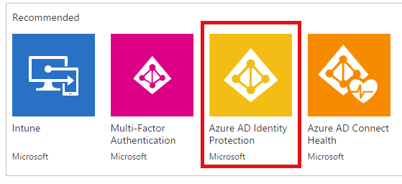
Azure Identity Protection
Provides:
A consolidated view of identity threats and vulnerabilities
Detailed notifications of identity risks
Automate responses to future risks with Conditional Access policies
Protects against:
Compromised accounts
Identity attacks
Configuration issues

Slide 5
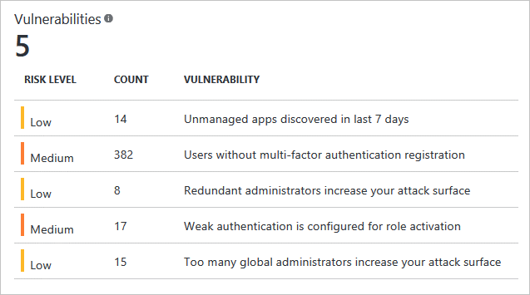
Vulnerabilities Detected
Security weaknesses that can be exploited by attackers, such as:
Users without multi-factor authentication registration
Excessive number of administrative accounts
Unmanaged apps
Each vulnerability includes:
Risk level
Count
Description

Slide 6
Demonstration: Enabling Multi-Factor Authentication
Notes:
Show how to enable multi factor authentication,
If the time permits, show the option for Conditional Access

Slide 7
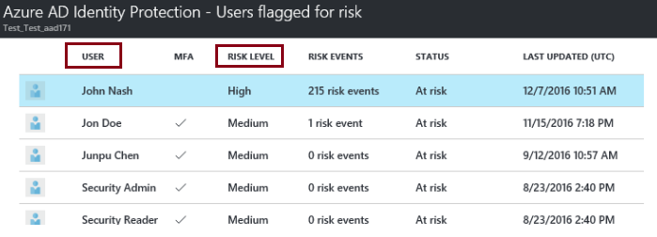
Risky Sign-Ins
Azure AD detects suspicious authentication-related actions:
Each detected action is associated with a risk event
Risk events are used to calculate:
Users flagged for risk – indicating that the corresponding account might have been compromised
Risky sign-ins – grouped into three categories, indicating likelihood of a compromised account:
High
Medium
Low

Slide 8
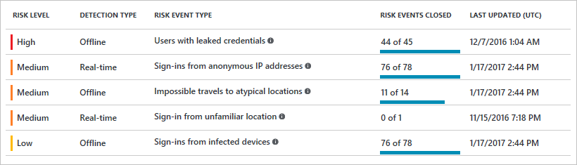
Risks Detected
Azure AD associates suspicious actions with risk events:
Identified by using machine learning algorithms and heuristics
Grouped into the following categories:
Impossible travel to atypical locations
Sign-ins from IP addresses with suspicious activity
Sign-ins from anonymous IP addresses
Sign-ins from unfamiliar locations
Sign-ins from infected devices
Users with leaked credentials

Slide 9
Video: Enabling Azure Active Directory Protection
Notes:
Better to show this video’s related part which is 03:34 to show the risk event types.
We have done the config settings already on slide 3 but this is the risk window you may repro

Slide 10
Lesson 2: Azure Domains and Tenants
Domains
Verifying Custom Domain Names
Tenants
Multiple Tenants
Video: Managing Domains Directories and Tenants
Demonstration: Create a New Instance of Azure AD
Practice: Custom Domain Names

Slide 11
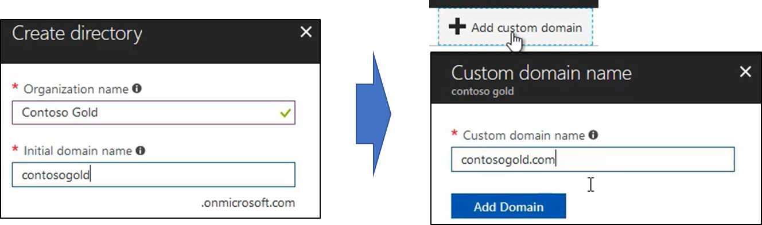
Domains
Each Azure AD tenant has one or more DNS domain names:
The initial domain name in the form domainname.onmicrosoft.com
Zero or more custom domain names:
Added by a member of the Global Administrator group
Must be added to the Azure AD tenant and verified.

Slide 12
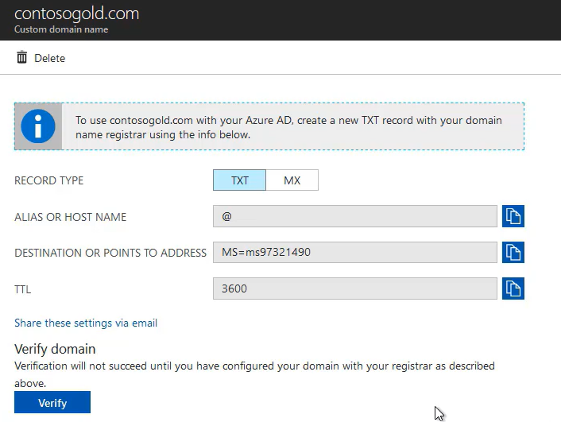
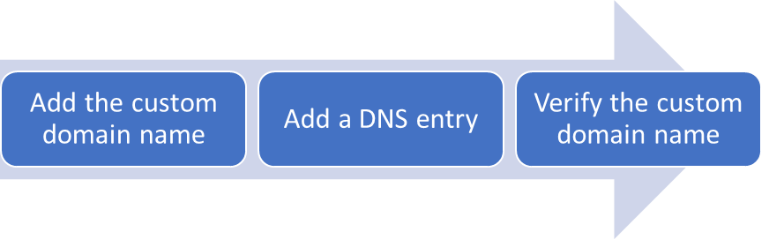
Verifying Custom Domain Names
To associate a custom domain name with an Azure AD tenant:
Add the custom domain name to the Azure AD tenant
Add a DNS entry to your DNS registrar:
A TXT or MX record
Azure AD provides the record value
Verify the custom domain name

Slide 13
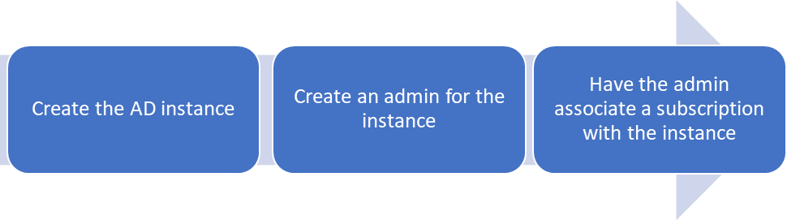
Tenants
Dedicated Azure AD instances:
Each tenant can host Azure AD objects, such as users, groups, and applications
A single organization can have multiple Azure AD tenants (e.g. testing and production)
Each Azure subscription must be associated with one and only one Azure AD tenant

Slide 14
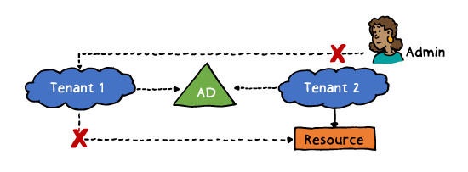
Multiple Tenants
Each Azure AD tenant is independent of others, including:
Resource independence:
Creating or deleting a resource in one tenant has no impact on other tenants (except for external users).
Assigning and verifying a custom domain name to one tenant precludes from using it with any other tenant.
Administrative independence:
By default, the user who creates a tenant is added as an external user in that new tenant and assigned the Global Administrator role in that tenant.
The administrators of one tenant do not have implicit administrative privileges to any other tenant.
Synchronization independence:
Synchronization with AD must be performed independently for each Azure AD tenant.

Slide 15
Video: Managing Domains Directories and Tenants
Notes:
Aurian.onmicrosoft.com is a tenant.
Cem.onmicrosoft.com is a tenant
Every directory must have independent subscriptions
Why multiple directories
You have multiple directories you want to synchronise different
Independent resources
Different administrators
Show to create a New directory
Create a new users with yourdomain.onmicrosoft.com
Show that you can sign in with that account on that AAD, even you can create a new
subscription on azurepass.com with that account
Show and explain the custom domain names idea.

Slide 16
Demonstration: Create a New Instance of Azure AD
Notes:
We already done steps on slide 15

Slide 17
Practice: Custom Domain Names
We did on previous slides.
Notes:
Additional Note,
If you want you can assign subscription under your domain.onmicrosoft.com AAD...

Slide 18
Lesson 3: Azure Users and Groups
Video: Managing Users and Groups
User Accounts
Adding User Accounts
Bulk User Accounts
Group Accounts
Demonstration: Create User and Group Accounts
Practice: Users and Groups

Slide 19
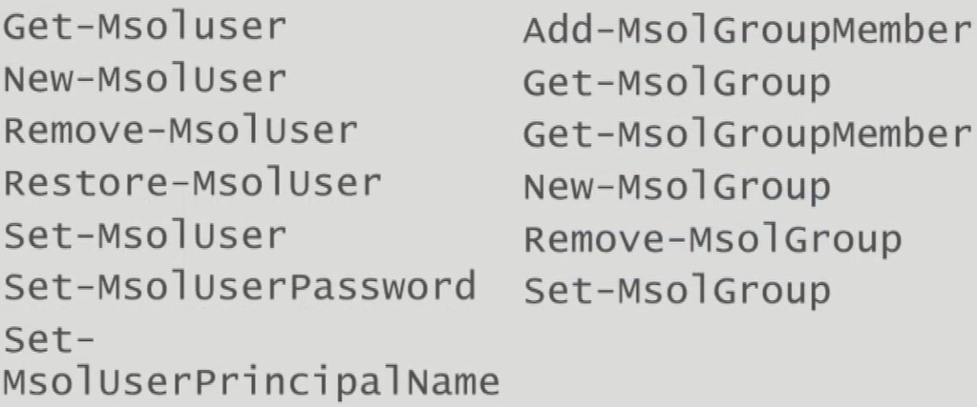
Video: Managing Users and Groups
Notes:
Show the user and group sets
Dynamic groups and how they are managed....
You can show this link below for further powershell steps.
Dynamic group will keep querying and updating the group members within all time period.
Here is an example for a dynamic group membership rule
(user.displayName -startsWith "Potato3")
This will show all the users starting with «potato03» you can define this depending on your own user naming convention
https://docs.microsoft.com/en-us/azure/active-directory/users-groups-roles/groups-dynamic-membership

Slide 20
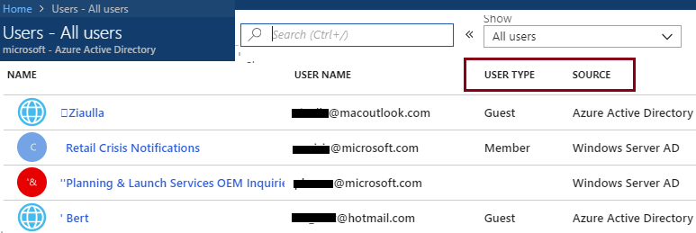
User Accounts
Azure AD object that facilitate:
User authentication
User authorization
Depending on the origin, Azure AD users can be categorized as:
Directory-synchronized identities
Cloud identities
Guest users

Slide 21
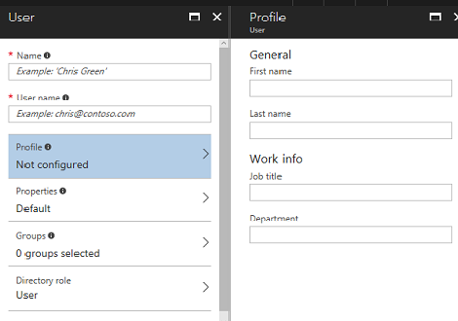
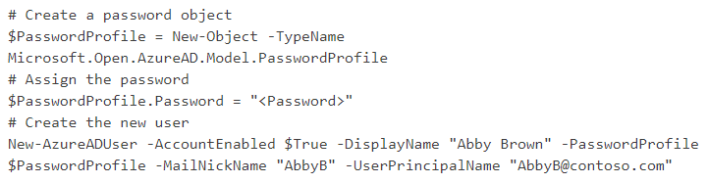
Adding User Accounts
Can be implemented by using:
The Azure portal
Azure PowerShell:
Office 365 Admin Center
Microsoft Intune admin console
Azure CLI

Slide 22
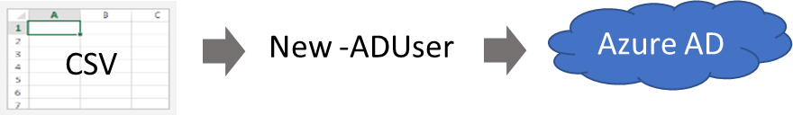
Bulk User Accounts
Implementation steps:
1. Use Connect-AzureAD to authenticate to Azure AD.
2. Create a new Password Profile for new users.
3. Use Import-CSV to import the csv file.
4. Loop through the users entries retrieving and constructing required user parameters.
5. Use New-ADUser to create and enable each user.

Slide 23
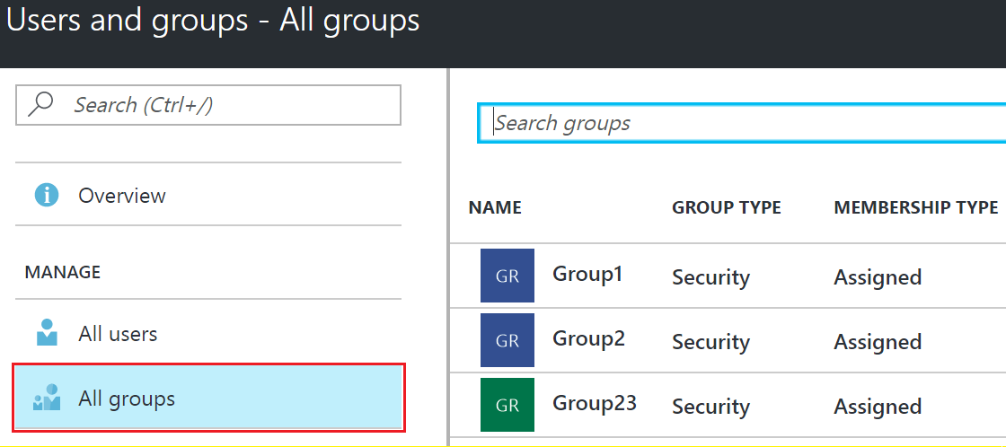
Group Accounts
Azure AD supports two types of groups:
Security groups for assigning permissions and delegating access to resources and apps
Distribution groups for messaging and collaboration
Group can be managed by using the same methods as user accounts
Azure AD supports two types of group membership:
Directly assigned
Dynamically assigned:
Relies on attribute-based rules
Requires Azure AD Premium P1 or P2

Slide 24
Demonstration: Create User and Group Accounts
Notes:
Remember we have configured a dynamic group.
We already synched from ADDS
Let’s try to invite an account to access the azure content from outside. (outlook. Or login.live compatible)
Use an existing account of any delegate, or create a different outlook account just to show that you can invite.
Tell that this ide can be used as audit purposes. Give detailed information about all possible real life scenarios

Slide 25
Practice: Users and Groups
We can do together if you prefer.
Notes:
Depending on the delegate’s performance hide or show this slide...
If the time permits, prefer to make the delegates do them...

Slide 26
Lesson 4: Azure Roles
Role-Based Access Control
Built-in Roles
Role Definitions
Azure PowerShell and CLI
Video: Role-Based Access Control
Demonstration: Role-Based Access Control
Practice: Role-based Access Control (RBAC)
Both Lesson 4 and Lesson 5 Demos of this module are already shown on
previous Module on T1 Mod 5.

Slide 27
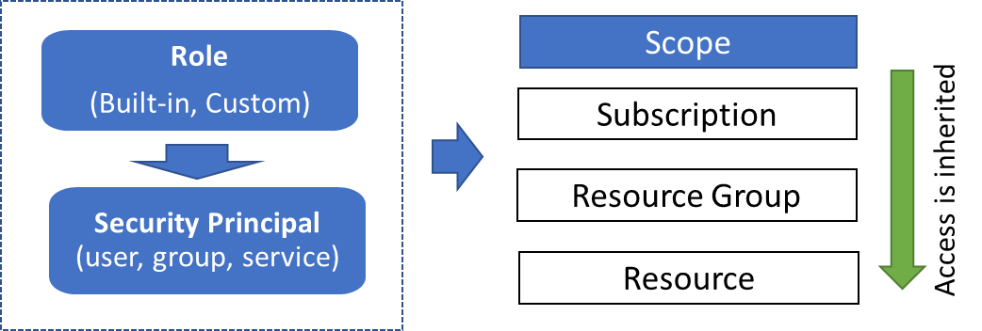
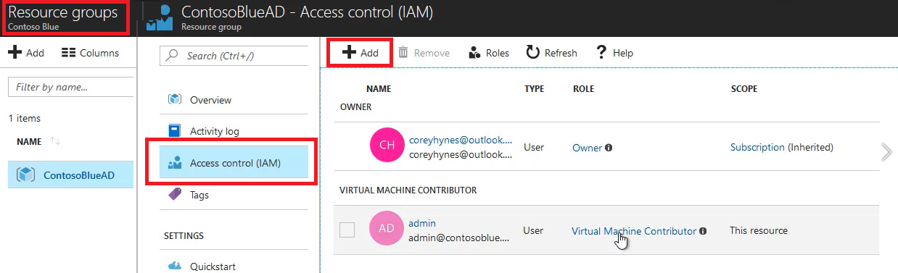
Role-Based Access Control
Facilitates granular access to Azure resources:
Consists of:
Role definition
Role assignment
Scope of assignment
Can be managed by using:
The Azure portal
Azure PowerShell
Azure CLI
ARM templates

Slide 28
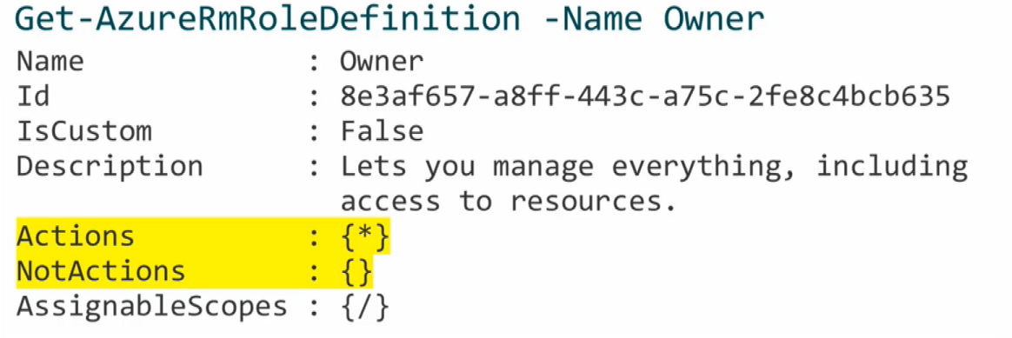
Built-in Roles
A role represents a set of permissions to carry out specific actions
Azure AD provides many built-in roles:
Built-in, not resource specific, including:
Owner: full access to all resources including the right to delegate access to others.
Contributor: creating and managing all resources but without the ability to delegate access to others.
Reader: viewing all resources (except for secrets).
Built-in, resource specific (e.g. Virtual Machine Contributor)
A role is described by a JSON-formatted role definition:
Name, Id, Actions, Not Actions, AssignableScopes
Can be retrieved by Get-AzureRmRoleDefinition

Slide 29
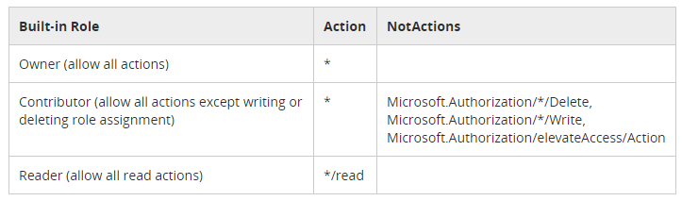
Role Definitions
Actions and NotActions:
Include or exclude actions associated with the role
AssignableScopes:
/subscriptions/[subscription id]
/subscriptions/[subscription id]/resourceGroups/[resource group name]
/subscriptions/[subscription id]/resourceGroups/[resource group name]/[resource]

Slide 30
Azure PowerShell and CLI
To automate role management, you can use:
Azure PowerShell:
New-AzureRmRoleDefinition -InputFile .\sysops.json
New-AzureRmRoleAssignment -RoleDefinitionName $roleName `
-SignInName $assigneeName `
-ResourceGroupName $resourceGroupName
Azure CLI:
az role definition create --role-definition “./sysops.json”
az role assignment create --role $roleName \ --assignee $assigneeName \ --resource-group $resourceGroupName

Slide 31
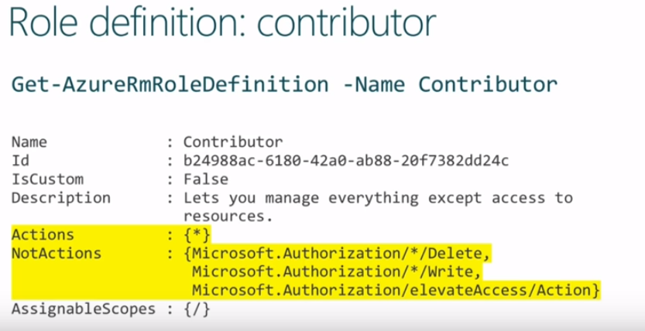
Video: Role-Based Access Control
Notes:
Remember we have assigned a custom role on previous module

Slide 32
Demonstration: Role-Based Access Control We have done this on previous Module

Slide 33
Practice: Role-based Access Control (RBAC)
Let’s do together. You can create your own tailored Role
Notes:
As a practice we can do together if you prefer OR if the time permits.

Slide 34
Lesson 5: Azure AD Integration Options
Azure AD Connect
Password Synchronization
Video: How to choose the right authentication option in Azure Active Directory
Video: Azure AD Seamless Sign-On
Sign-On Methods
Video: Pass-through Authentication
Video: Azure AD DS Integration Options
Demonstration: Azure AD Connect
Practice: Azure AD Pass-through Authentication
Azure AD Connect Health
Video: Monitoring Synchronization using Azure AD Health

Slide 35
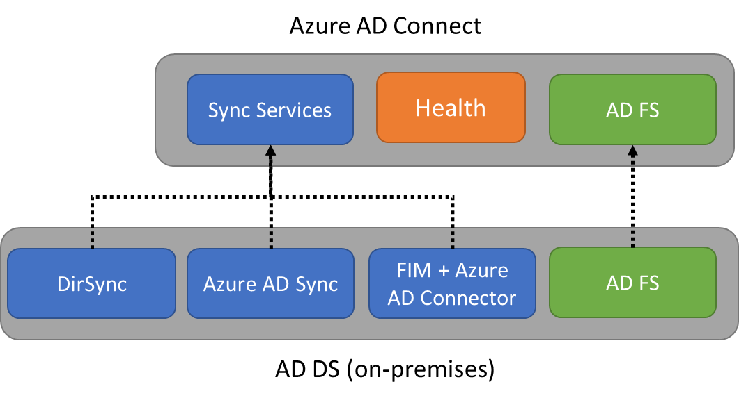
Azure AD Connect
Integrates AD DS with Azure AD:
Implements a common identity for your users across Azure, Office 365, and SaaS apps
Provides support for:
Sync Services: synchronize AD DS objects, such as users and groups.
Health Monitoring: offers centralized monitoring available from the Azure portal.
Federation: simplifies configuration of AD FS, including:
enforcement of AD sign-in policies
smart card or 3rd party MFA

Slide 36
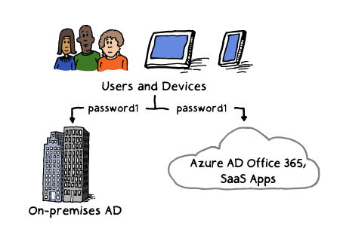
Password Synchronization
Supported by Azure AD Connect:
Synchronizes user passwords from AD DS to Azure AD
Allows users to use their AD credentials in order to access:
Azure resources
Office 365
Microsoft Intune
Dynamics 365
Azure AD DS
Improves user productivity
Reduces helpdesk costs

Slide 37
Video: How to choose the right authentication option in Azure Active Directory
Notes:
We have seen and discussed this idea on previous module

Slide 38
Video: Azure AD Seamless Sign-On
Notes:
We have seen and discussed this idea on previous module

Slide 39
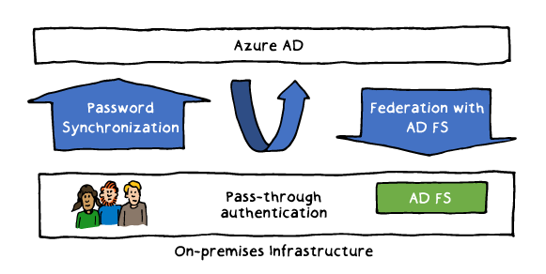
Sign-On Methods
Available when using Azure AD Connect:
Password Synchronization: synchronizes AD DS user password hashes
Federation with AD FS: uses federation to redirect authentication requests to AD DS
Pass-through authentication: redirects authentication requests to AD DS without dependency on a federation service

Slide 40
Video: Pass-through Authentication

Slide 41
Video: Azure AD DS Integration Options

Slide 42
Demonstration: Azure AD Connect

Slide 43
Practice: Azure AD Pass-through Authentication

Slide 44
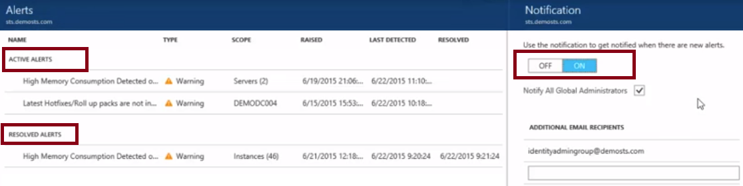
Azure AD Connect Health
Provides monitoring of AD DS and Azure AD integration:
Azure AD Connect and its synchronization engine
AD DS domain controllers
AD FS servers

Slide 45
Video: Monitoring Synchronization using Azure AD Health

